Slide 1


CENTRE OF EXCELLENCE FOR AI • ADVANCED EXCEL PROJECT REPORT
Mapple Employee Performance
& Payroll Management Analytics
An interactive, Pivot-based Excel analytics dashboard evaluating workforce
productivity, compensation structure, and regional payroll allocation
Somnath Mondal (AF05325748) Arpita Dhar (AF05325379)
Trainer: Sayan Sau Duration: 4 Days Submission: 28/08/2026

Slide 2





PROJECT OVERVIEW
Introduction
This project builds a data-driven Excel analytics framework to evaluate workforce productivity, compensation structure, demographic distribution, and regional payroll allocations — using 2,000 real employee records sourced from Kaggle.
2,000
12
Employee Records
Data Attributes
The model evaluates compensation consistency across HR, IT, and Sales, tracks experience-to-salary progression, measures appraisal coverage gaps, and models employee retention across three major corporate locations.
3
3
Corporate Locations
Departments Analyzed
Goal: Transform disjointed HR data into a single interactive Pivot-based dashboard that supports fair pay, performance tracking, and regional cost decisions.
Employee Performance & Payroll Dashboard
2

Slide 3




BACKGROUND
Problem Statement
Modern enterprise HR operations frequently face structural inefficiencies due to disjointed compensation models, missing appraisal records, and unmonitored regional payroll disparities.
Compensation Disconnect
Evaluation Tracking Gaps
Geographic Cost Variances
Attrition & Inactivity
Lack of clear alignment between employee experience, age, and pay — leading to wage compression or arbitrary pay scales.
Incomplete annual performance evaluations leave management without data to distribute merit-based bonuses.
Unmonitored regional payroll variances across Chicago, LA, and New York create budget overruns without proportional output.
Nearly 50% of employee accounts are inactive, complicating headcount planning and resource optimization.
These four gaps compound into inconsistent pay, incomplete appraisals, budget overruns, and stale headcount data.
Employee Performance & Payroll Dashboard
3

Slide 4
WHAT WE SET OUT TO DO
Project Objectives
1
Construct a data-driven Excel analytics framework to evaluate workforce productivity and compensation structure.
2
Evaluate compensation consistency across functional departments — HR, IT, and Sales.
3
Track experience-to-salary progression across the organization.
4
Measure appraisal coverage gaps in performance rating data.
5
Model employee retention dynamics across major corporate locations.
6
Deliver an interactive, structured Pivot-based analytical dashboard for decision-making.
Employee Performance & Payroll Dashboard
4

Slide 5

DATA ARCHITECTURE
Dataset Overview
2,000 individual employee records spanning 12 transactional attributes, sourced from Kaggle.
Demographics
Workforce Operations
Financials & Performance
Employee ID & Name
Department — HR 659 · IT 696 · Sales 645
Monthly salary: $2,015 – $9,993 (avg $5,971.31)
Age: range 18–65 (avg 41.25 yrs)
Branch — Chicago 677 · LA 678 · New York 645
Work experience: 1–20 yrs (avg 10.27 yrs)
Gender — Female 663 · Male 653 · Other 684
Shift — Morning 678 · Evening 652 · Night 670
Performance rating (1.0–5.0): 989 recorded, 1,011 null
Status — Active 1,007 · Inactive 993
Employee Performance & Payroll Dashboard
5

Slide 6




TOOLS & METHODOLOGY
Data Analysis Process
STEP 1
STEP 2
STEP 3
STEP 4
Clean & Transform
Calculate & Flag
Model & Aggregate
Design the Dashboard
▸
▸
▸
Power Query automated cleaning — standardized text formats, date formatting, missing-value imputation, and categorical indexing.
COUNTIF, AVERAGEIFS, SUMIFS, MAX/MIN, XLOOKUP, dynamic matrix formulas and conditional logical flags.
Dynamic Pivot Tables, Pivot Charts, timeline slicers, and multi-variable cross-tabulations.
KPI scorecards, visual hierarchy formatting, color-coded status badges, and interactive control slicers.
Employee Performance & Payroll Dashboard
6

Slide 7
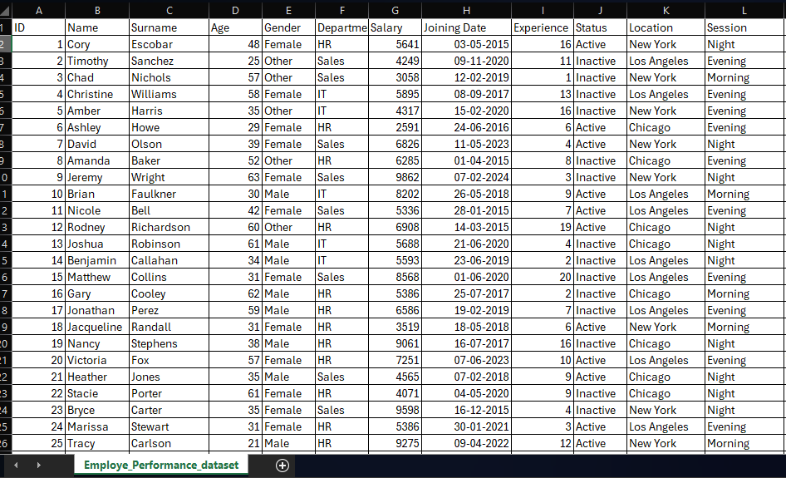
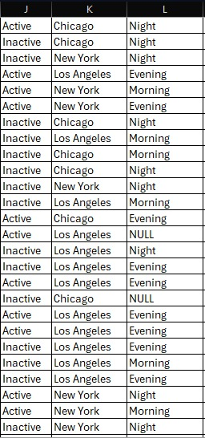
Data Cleaning
In data cleaning we have NULL values in shift column so we remove the NULL values .
In comparisons of the total data NULL values are less that is why we remove all the null values
In data cleaning we have 2 columns name and surname we merge this 2 columns and create a single column names name .

Slide 8


THE EXECUTIVE VIEW
Dashboard Overview
Gender Distribution
2,000
$11.94M
Total Headcount
Total Payroll Expense
$5,971.31
10.27 yrs
Avg Monthly Salary
Average Tenure
Interactive Controls
Location — Chicago, Los Angeles, New York
Department — HR, IT, Sales
Status — Active, Inactive
Conditional Formatting Alerts: Flags outliers, low scores & incomplete evaluations.
Employee Performance & Payroll Dashboard
7

Slide 9
KEY ANALYSIS I
Workforce Distribution
Distribution of Gender
Distribution of Department
Distribution of Work Shifts
Distribution of Branch Locations
Employee Performance & Payroll Dashboard
8

Slide 10
KEY ANALYSIS II
Regional Experience vs. Compensation
Average monthly salary by location and department — Los Angeles HR leads at $6,417.48, while balanced staffing holds experience levels close across all cities.
Location Subtotals
Average Salary by Location & Department ($)
Chicago
Avg Exp: 10.00 yrs
Avg Salary: $5,951.57
Los Angeles
Avg Exp: 10.41 yrs
Avg Salary: $6,068.58
New York
Avg Exp: 10.41 yrs
Avg Salary: $5,889.78
Employee Performance & Payroll Dashboard
9

Slide 11
KEY ANALYSIS III
Demographics & Employment Status
Active vs. Inactive Headcount by Location
Average Age by Location & Department
Employee Performance & Payroll Dashboard
10

Slide 12


DEEP-DIVE INSIGHTS
Major Findings
Highest Earning Segment
Flat Wage-to-Experience Curve
Los Angeles HR professionals command the highest average salary at $6,417.48 with 10.96 years of experience. New York IT is the lowest at $5,758.29.
Org-wide average experience is 10.27 years against $5,971.31 average pay — minimal variance between junior and senior staff.
Performance Rating Gap
Balanced Shift Coverage
Over 50% of employee profiles (1,011 of 2,000) lack an assigned performance score — appraisal systems need tighter integration with payroll.
Headcount is spread evenly across Morning (678), Evening (652), and Night (670) shifts — solid operational coverage around the clock.
Employee Performance & Payroll Dashboard
11

Slide 13

WRAPPING UP
Conclusion
The Employee Performance & Payroll Analytics Dashboard transforms raw workforce transactional data into a powerful decision-making system.
By addressing key operational gaps — unrecorded performance ratings, flat pay-to-experience progression, and regional cost differences — organization leadership can optimize payroll allocation, improve employee performance evaluation, and foster sustained retention.
Learning Outcomes
Mastered multi-variable dynamic Pivot Table creation, custom grouping, and cross-tabulation
Structured raw Kaggle HR data using Power Query and advanced cleaning routines
Designed an interactive executive dashboard with KPI scorecards, alerts, and slicers
Derived actionable business recommendations from demographics, salary, and rating data
Employee Performance & Payroll Dashboard
12

Slide 14

FUTURE SCOPE
Strategic Recommendations
Implement Merit-Based Pay Bands
Standardize compensation tiers based on experience and performance scores to ensure equitable salary growth and boost retention.
Mandate Performance Appraisal Tracking
Establish quarterly appraisal deadlines to resolve the current 50.55% gap in performance rating data.
Optimize Regional HR Allocation
Review compensation in Los Angeles HR ($6,417.48 average) and realign salary benchmarks across regional offices.
Audit Inactive Employee Accounts
Conduct a thorough audit of the 993 inactive profiles to keep system records current and reduce administrative overhead.
Employee Performance & Payroll Dashboard
13

Slide 15
Thank You
Questions & Discussion
Somnath Mondal (AF05325748) · Arpita Dhar (AF05325379)
GitHub: Somnaths13 · adarpitadhar13-DA
Centre of Excellence for AI — Advanced Excel Project

